Slide 1


St. MARTIN’S ENGINEERING COLLEGE
UGC Autonomous
NBA & NAAC A+ ACCREDITED
Dhulapally, Secunderabad– 500100
Department of Computer Science and Engineering
A Recurrent CNN for Automatic Detection and Classification of Coronary Artery Plaque and Stenosis in Coronary CT Angiography
Batch No: 17
1. Bhupendra Kumar (19K81A05C4)
2. Mohammed Anwar (19K81A05F8)
3. Sagar Sharma (19K81A05G7)
Under the Guidance of
Mrs. E. Soumya
Associate Professor
Department of Computer Science and Engineering

Slide 2
OUTLINE
Abstract
Introduction
Existing System
Proposed System
System Design
Result Analysis
Conclusion and Future Enhancement
References

Slide 3
ABSTRACT
Various types of atherosclerotic plaque and varying grades of stenosis could lead to different management of patients with coronary artery disease. Therefore, it is crucial to detect and classify the type of coronary artery plaque, as well as to detect and determine the degree of coronary artery stenosis.
To define the reference standard, the presence and the type of plaque in the coronary arteries as well as the presence and the anatomical significance of coronary stenosis were manually annotated in the MPR images by identifying the start- and end-points of the segment of the artery affected by the plaque.
First, a 3D convolutional neural network is utilized to extract features along the coronary artery. Subsequently, the extracted features are aggregated by a recurrent neural network that performs two simultaneous multiclass classification tasks.
First task, to detect type of coronary artery plaque. Second task, to detect significance of stenosis.

Slide 4
INTRODUCTION
Coronary artery disease (CAD) is the most common type of heart disease. CAD occurs when atherosclerotic plaque builds up in the wall of the coronary arteries. This may lead to stenosis, i.e. narrowing or occlusion of the coronary artery lumen, limiting blood supply to the myocardium and potentially leading to myocardial ischemia. Atherosclerotic plaque can be classified according to its composition into calcified plaque, non-calcified plaque, and mixed plaque, i.e plaque containing calcified and non-calcified components.
Given the importance of plaque detection, a number of methods for coronary artery plaque detection and quantification have been proposed. Thus far, (semi-)automatic methods have been designed to detect either calcified or non-calcified plaque.
While the visual detection of calcified plaque is straightforward in CT/CCTA due to its higher CT density, the detection of noncalcified and especially mixed plaque is more challenging because of low contrast with adjacent tissues. Therefore, unlike methods detecting calcifications, standard visual evaluation as well as (semi-)automatic approaches detecting non-calcified plaque typically analyse straightened multi-planar reformatted (MPR) images.

Slide 5
INTRODUCTION
To perform the automatic comprehensive analysis, a multi-task recurrent convolutional neural network (RCNN) is employed to analyse the vicinity along the extracted centreline in an MPR image and to simultaneously carry out two classification tasks. In the first task, the network detects and characterizes the type of the coronary artery plaque, i.e. no plaque, non-calcified, mixed or calcified plaque. In the second task, the network detects and determines the anatomical significance of the coronary artery stenosis, i.e. no stenosis, non-significant or significant stenosis.
Firstly, we propose to jointly classify plaque and stenosis, while previously proposed methods have detected either plaque or stenosis. Secondly, unlike previous automatic methods, our method does not require segmentation of the coronary artery lumen, instead, it only requires the coronary artery centreline. Thirdly, we are the first to use deep neural networks to approach the task of coronary artery plaque and stenosis analysis, or more specifically a 3D-CNN paired with an RNN to analyse medical data. Finally, previous works for classifying coronary artery plaque require detailed reference annotations for each voxel affected by the plaque.

Slide 6
EXISTING SYSTEM
Coronary artery disease (CAD) is the most common type of heart disease . CAD occurs when atherosclerotic plaque builds up in the wall of the coronary arteries. This may lead to stenosis, i.e. narrowing or occlusion of the coronary artery lumen, limiting blood supply to the myocardium and potentially leading to myocardial ischemia. Atherosclerotic plaque can be classified according to its composition into calcified plaque, non-calcified plaque, and mixed plaque, i.e plaque containing calcified and non-calcified components. All existing algorithms were able to predict presence of Plaque or Not but they will not predict Significance of Stenosis.

Slide 7
PROPOSED SYSTEM
In propose system author has applied Recurrent Convolution Neural Network (RCNN) to detect plaque and Stenosis from Coronary Artery CCTA (clinically obtained coronary CT angiography) images and to overcome from this problem author has introduced RCNN which can predict two task. In task one RCNN predict Plaque classification and in task two predict percentage of Stenosis. White line in image indicate Stenosis percentage and if percentage is more than 50 then Stenosis presence detected. To implement this project author has used annotated images from experts which classify plaque into ‘No-Plaque, Non-Calcified, Mixed and Calcified’ but we are unable to find such dataset so we are predicting Healthy and Plaque images and then calculating percentage of Stenosis.

Slide 8
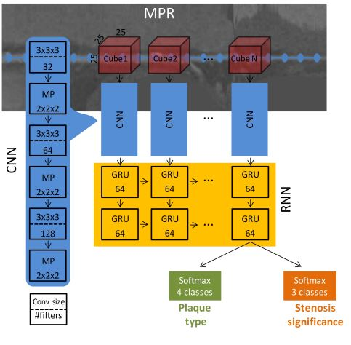
ARCHITECTURAL DESIGN FOR PROPOSED SYSTEM
The input of the network is a sequence of a maximal length of 25 cubes of 25 × 25 × 25 voxels with stride of 5 voxels along the coronary artery centerline, extracted from the MPR.
Each cube is analyzed by a 3D CNN. The CNN consists of three convolutional layers with kernels of 3 × 3 × 3, with 32, 64, 128 filters, respectively.
Each convolutional layer is followed by 2 × 2 × 2 max-pooling layer and batch normalization. The features extracted by the CNN are fed to the RNN, which models the sequential information.
The RNN consists of 2 layers of 64 Gated Recurrent Units (GRUs) each. Rectified linear units (ReLU) are used in both CNN and RNN layers as activation functions.
The output of the last layer of the RNN is fed into two separated multi-label softmax classifiers.
The network has a total number of 340,295 parameters.

Slide 9
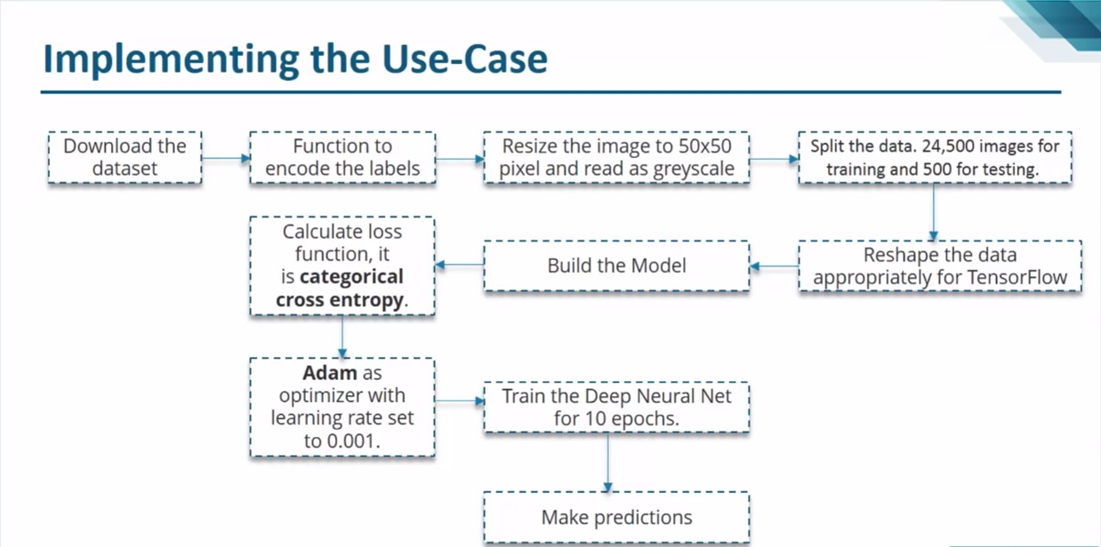
FLOW DIAGRAM

Slide 10
MODULES
Upload CCTA Scan Plaque Dataset: Using this module we will upload CCTA images to application.
Dataset Pre-processing: Using this module we will read all images, then resize all images to equal size. then normalize all images values and then split dataset images into train and test where application using 80% images for training 20% for testing.
Generate & Load RCNN Model: Using this module we will train RCNN using 80% images and then test RCNN performance by applying 20% test images prediction.
Plaque Classification: Using this module we will upload test image and then RCNN will predict presence of Plaque and stenosis.
RCNN Training Graph: Using this module we will plot RCNN training accuracy and loss graph.

Slide 11
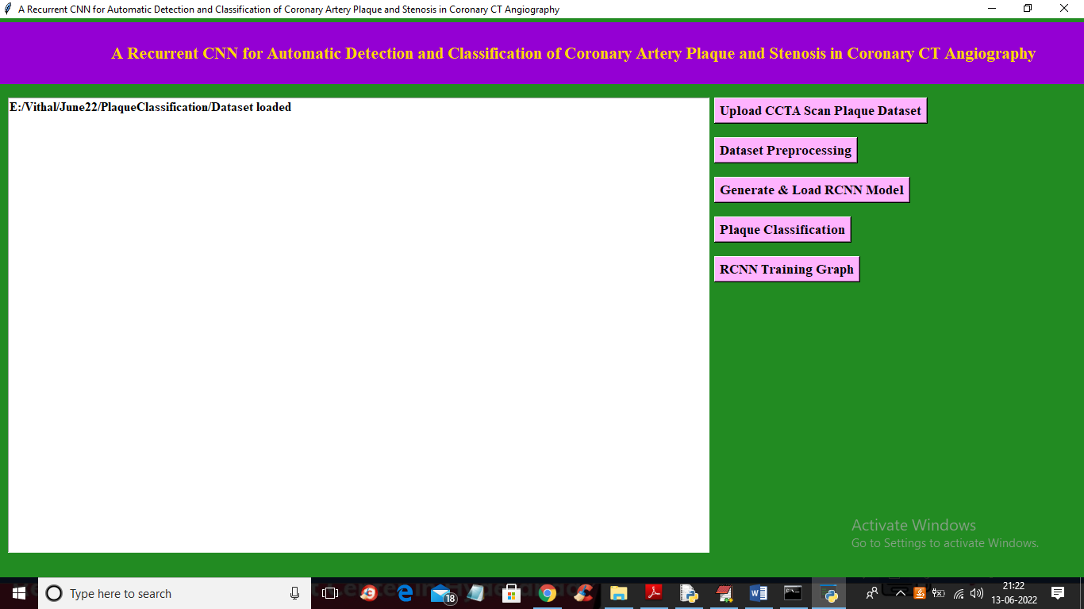
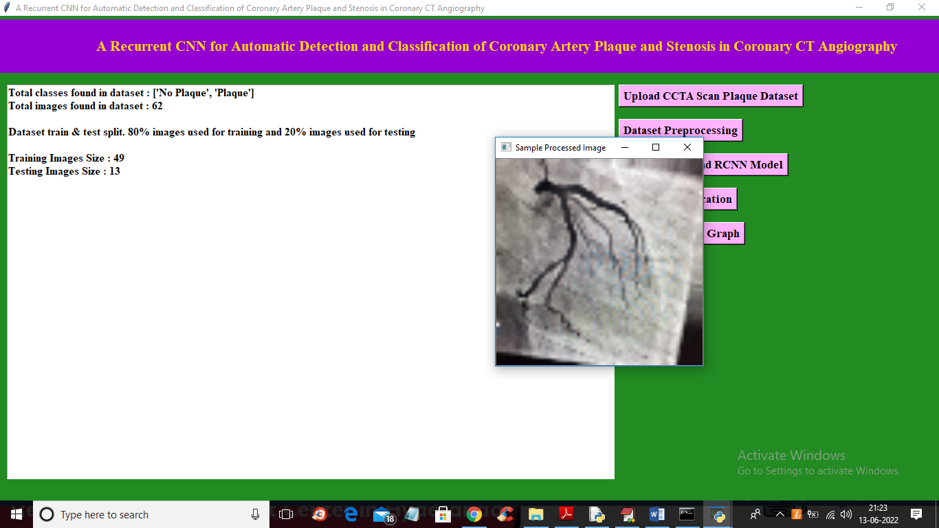
RESULTS ANALYSIS
DATASET PRE-PROCESSING
GENERATE AND LOAD RCNN MODEL

Slide 12
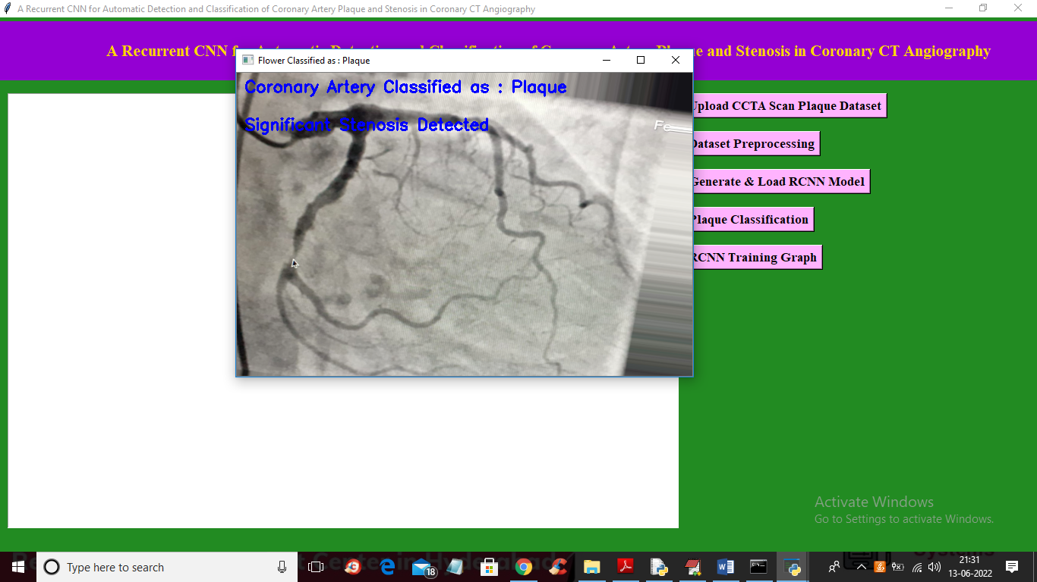
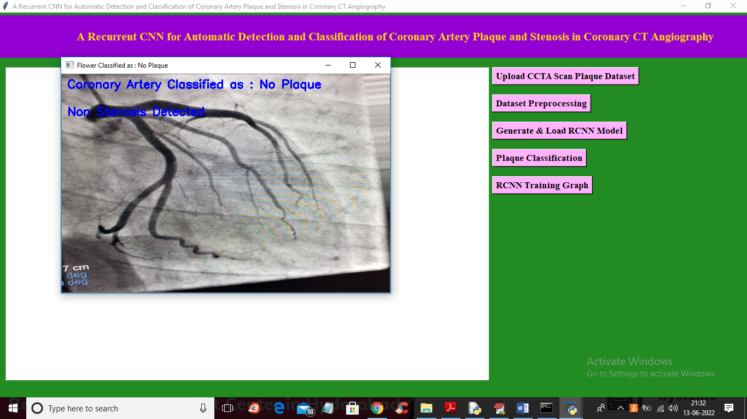
RESULTS ANALYSIS
CLASSIFIED AS PLAQUE
CLASSIFIED AS NO PLAQUE

Slide 13
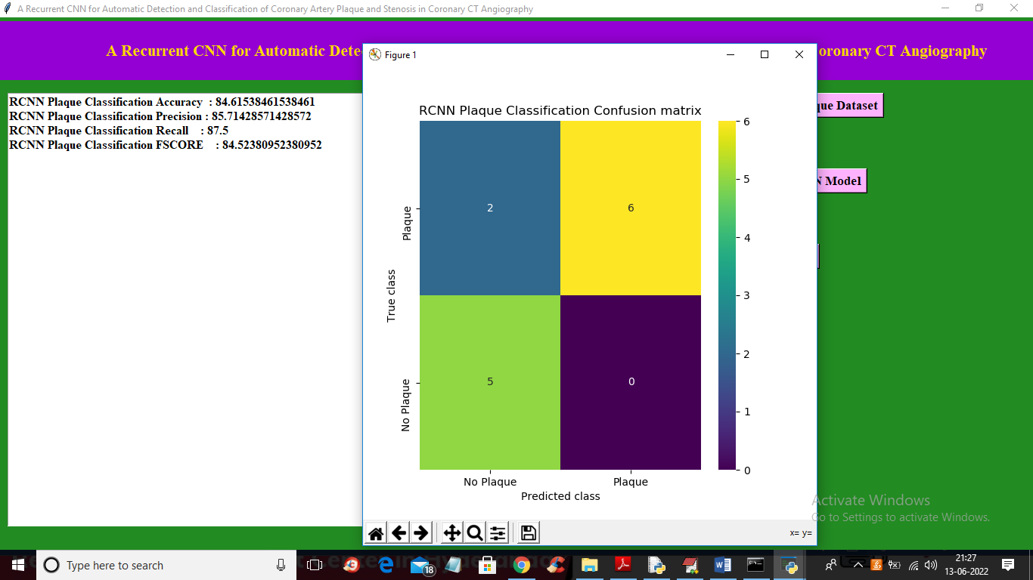
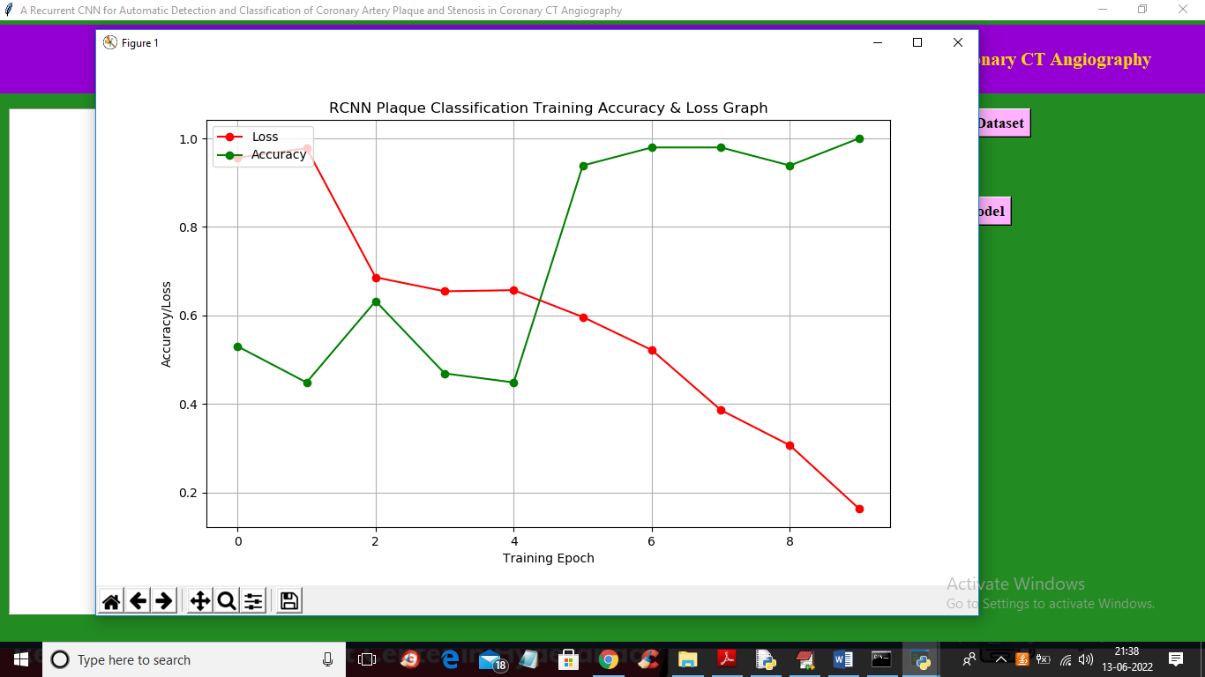
RESULTS ANALYSIS
CONFUSION MATRIX FOR PLAQUE CLASSIFICATION
TRAINING ACCURACY AND LOSS GRAPH

Slide 14
CONCLUSION AND FUTURE ENHANCEMENT
A method for automatic detection and characterization of the coronary artery plaque type, as well as detection and characterization of the anatomical significance of the coronary artery stenosis was presented.
The method employs an RCNN that analyses an MPR view of a coronary artery extracted from a CCTA scan using the coronary artery centreline, an RNN analyses the computed image features to perform both classification tasks. Unlike most previous methods that detect and characterize coronary artery plaque and stenosis relying on the coronary artery lumen segmentation.
RNN and RCNN can be used in future enhancement of this automation and can be implemented for both classification of plaque and detection of stenosis in coronary artery as the present method requires only the coronary artery centreline as an input along with the CCTA image.

Slide 15
REFERENCES
[1]. A. Karpathy and L. Fei-Fei, “Deep visual-semantic alignments for generating image descriptions,” in Proceedings of the IEEE Conference on Computer Vision and Pattern Recognition, 2015, pp. 3128–3137.
[2]. K. Cho, B. Van Merriënboer, C. Gulcehre, D. Bahdanau, F. Bougares, H. Schwenk, and Y. Bengio, “Learning phrase representations using rnn encoder-decoder for statistical machine translation,” arXiv preprint arXiv:1406.1078, 2014.
[3]. A. Arbab-Zadeh and J. Hoe, “Quantification of coronary arterial stenoses by multidetector CT angiography in comparison with conventional angiography: methods, caveats, and implications,” JACC: Cardiovascular Imaging, vol. 4, no. 2, pp. 191–202, 2011.

Slide 16
REFERENCES
[4]. D. Dey, T. Schepis, M. Marwan, P. J. Slomka, D. S. Berman, and S. Achenbach, “Automated three-dimensional quantification of noncalcified coronary plaque from coronary CT angiography: comparison with intravascular US,” Radiology, vol. 257, no. 2, pp. 516–522, 2010.
[5]. M. J. Budoff, D. Dowe, J. G. Jollis, M. Gitter, J. Sutherland, E. Halamert, M. Scherer, R. Bellinger, A. Martin, R. Benton et al., “Diagnostic performance of 64-multidetector row coronary computed tomographic angiography for evaluation of coronary artery stenosis in individuals without known coronary artery disease: results from the prospective multicenter ACCURACY trial,” Journal of the American College of Cardiology, vol. 52, no. 21, pp. 1724–1732, 2008.
[6]. L. Antiga and D. A. Steinman, “Robust and objective decomposition and mapping of bifurcating vessels,” IEEE Transactions on Medical Imaging, vol. 23, no. 6, pp. 704–713, 2004.

Slide 17
QUERIES ??

Slide 18
THANK YOU

